Slide 1
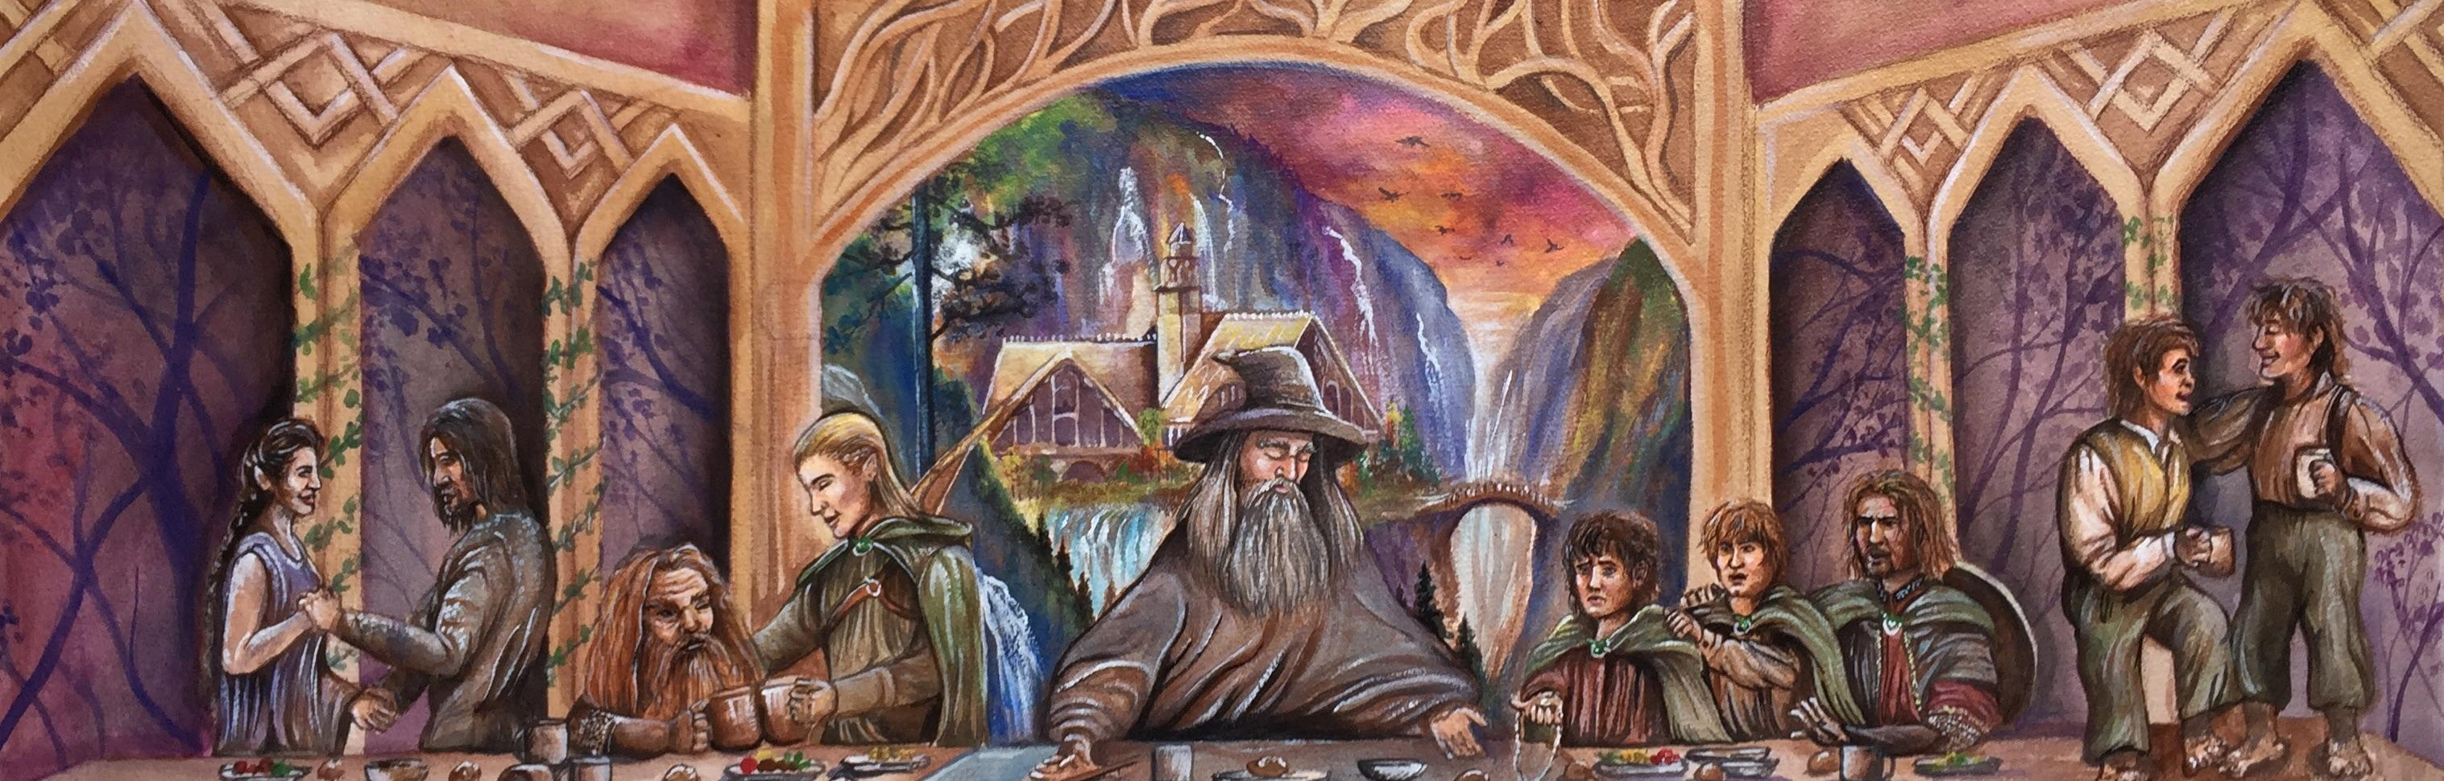
Commensality at the Domes Client: SCHA & SLLC
D-Lab I
Winter 2023
Tim Burton, Kristen Becker, Joshua Ian Ira

Slide 2
Project Statement
The goal of this project is to work with the domes community to design a functional shared space that provides essential services to the residents while strengthening community engagement
Experiential Learning
Food, Land, and Water
Community
Experiential Learning
Sustainability
Notes:
Our clients are particularly concerned with promoting community bonding and relationship building, since this is the backbone of a cooperative living community. To sustain this system and foster growth of community ties that were lost to the pandemic, a functional and accessible common space is needed.

Slide 3
Methodology
Prior Art
Needs Assessment
Design Criteria
Site Inventory
Conceptual Design
Evaluation

Slide 4
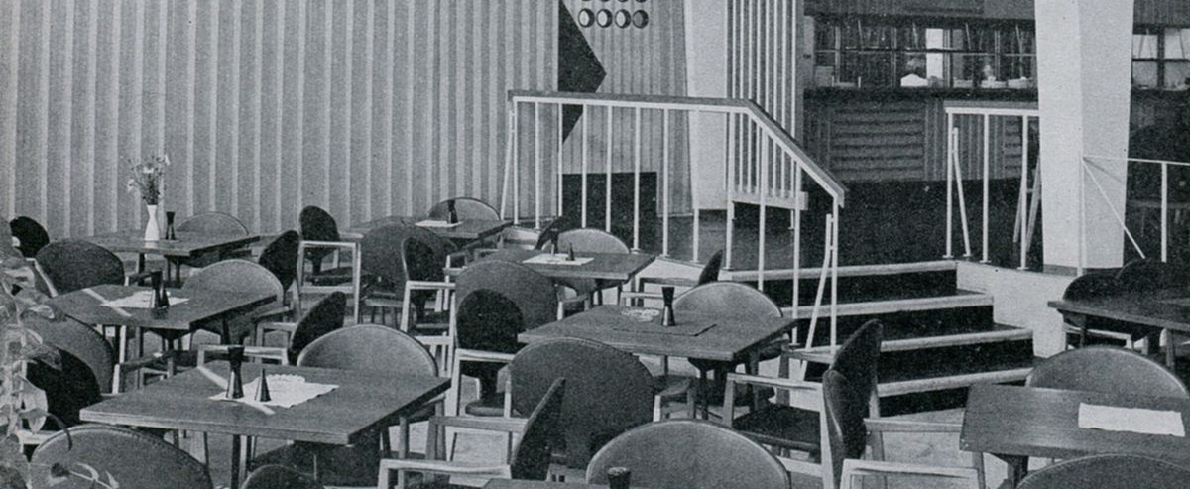
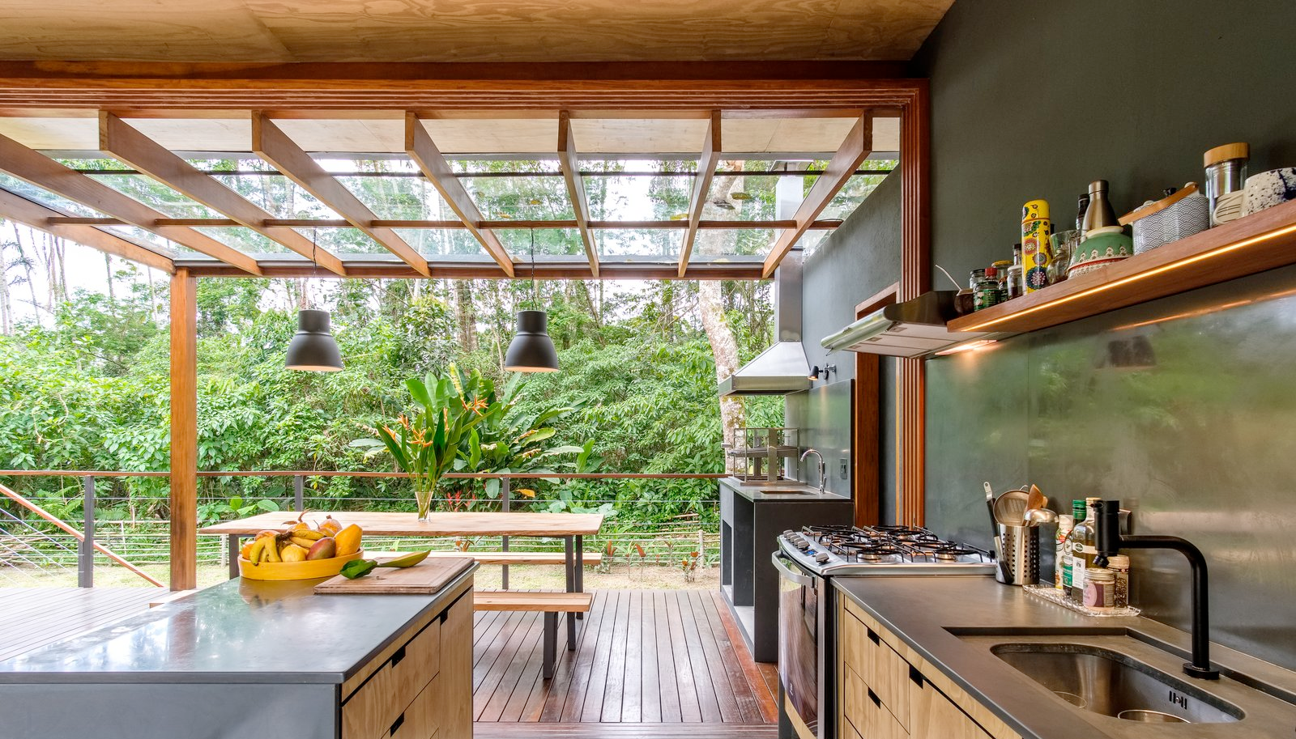
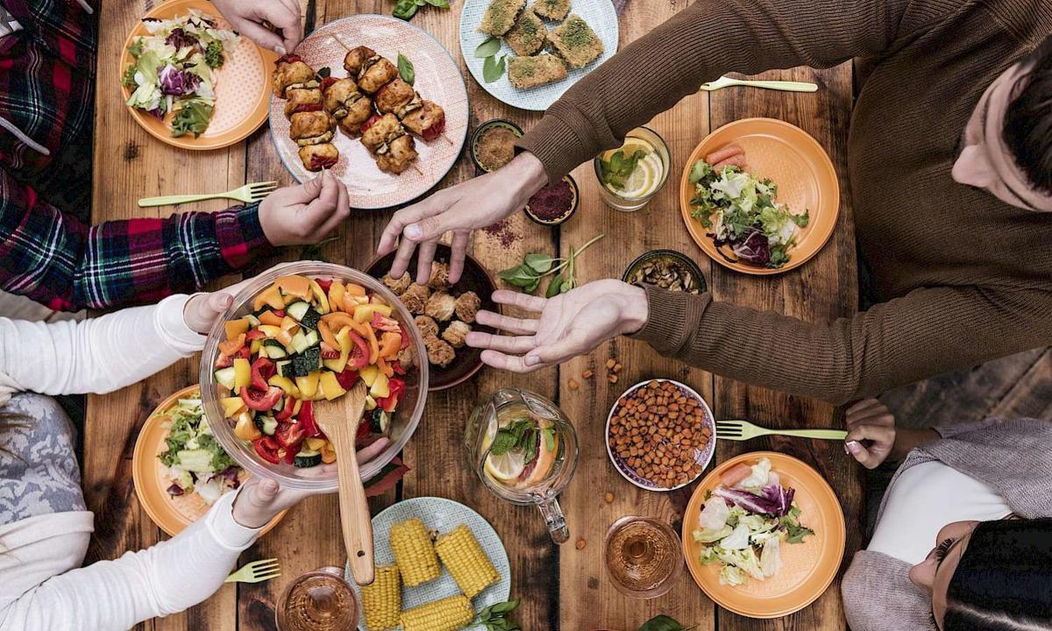
Notes:
A central element of the common space is a community kitchen, where domies could cook and share meals together. In the past, the domes community relied on a “potluck” style meal sharing, in which individuals cooked in their respective domes before sharing with their peers. This space could also be used as a place to gather for group activities and could potentially include supplementary housing and amenities like laundry machines and extra bathrooms. We plan on working closely with the domes community to capture their needs and understand what would be useful for them.
Case studies on community building, both bonding and linking:
Hässelby family hotel: solidarity against class conflict,
Soy Nica: food justice and public outreach,
Urban Aboriginal Community Kitchen: preserving food culture, cooking therapy

Slide 5
Needs Assessment: Key Insights
Notes:
Kitchen, Laundry, and Dining Space
Emphasis on functional spaces
Sustainable design elements
The fist step in our needs assessment was surveying the current Domies. We obtained a 50% response rate and these are some key insights we found. Firstly , we asked which of the following building types would you prefer to use as a common space, and a majority of Domies were neutral the the building type as long as it was a functional space. We then asked them to rank and select which elements they find most important. As shown here the modt selected was for dining space, meeting space, a kitchen, and laundry. But when they were asked to rank their most important elements, the need for a kitchen won out as seen here, followed by laundry, dining space, and supplemental housing.

Slide 6
Vision for the conceptual design
Current Residents
Prior Residents
Functional spaces that are multi-purpose and low maintenance
Sustainable design elements
Improved lighting
Central location
Community garden and livestock
Long lasting and thoughtful design that promotes circularity within waste streams
Improved accessibility
Spaces that encourage cooperative living and community interaction
Designs that preserve the domes aesthetic
Notes:
For the second part of our needs assessment, we interviewed two Prior Dome residents to understand how communal space functioned while they were living there during a time before covid, when the community culture was strong and thriving.
We found that prior residents stressed the importance of community building elements, like a central location, community garden and livestock opportunities, and a long-lasting thoughtful design. Current residents are more focused on functionality, like low maintenance spaces, improved lighting, and sustainable design elements.
Both groups stressed the need for improved accessibility, spaces that encourage cooperative living, and designs that preserve the domes aesthetic

Slide 7
Design Criteria
Need
Community Impact
Functionality
Sustainability
+
Feasibility
Cost
Notes:
Based on the results of the needs assessment, we have distilled our design criteria down to 6 major elements. These are comprehensive

Slide 8
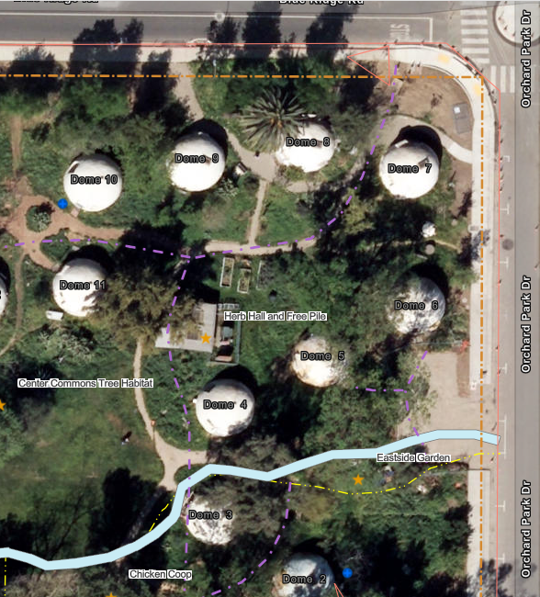
Site Inventory

Slide 9
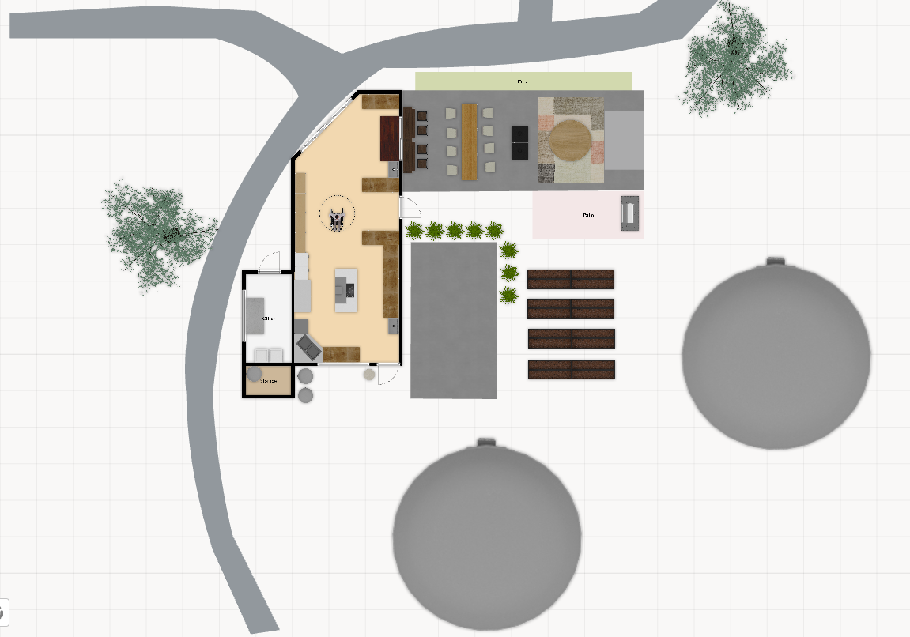
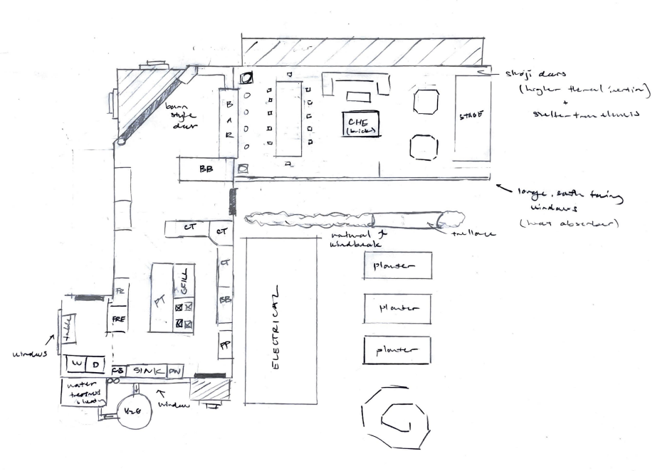
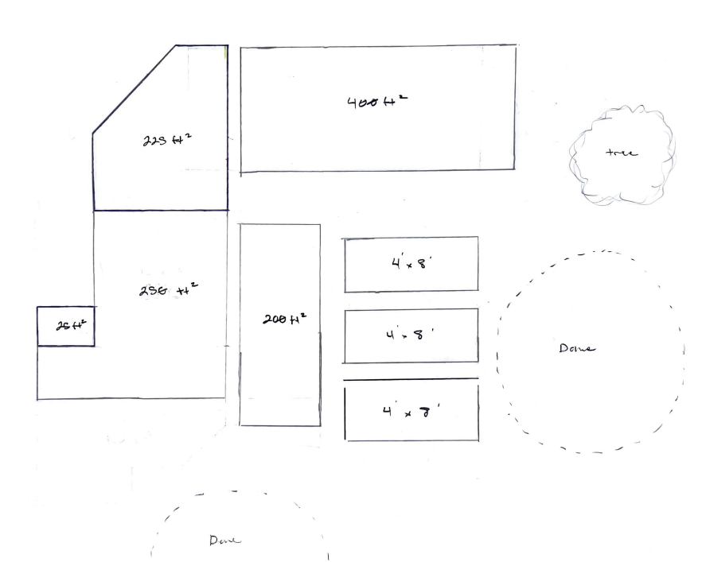
Herb Hall Kitchen

Slide 10
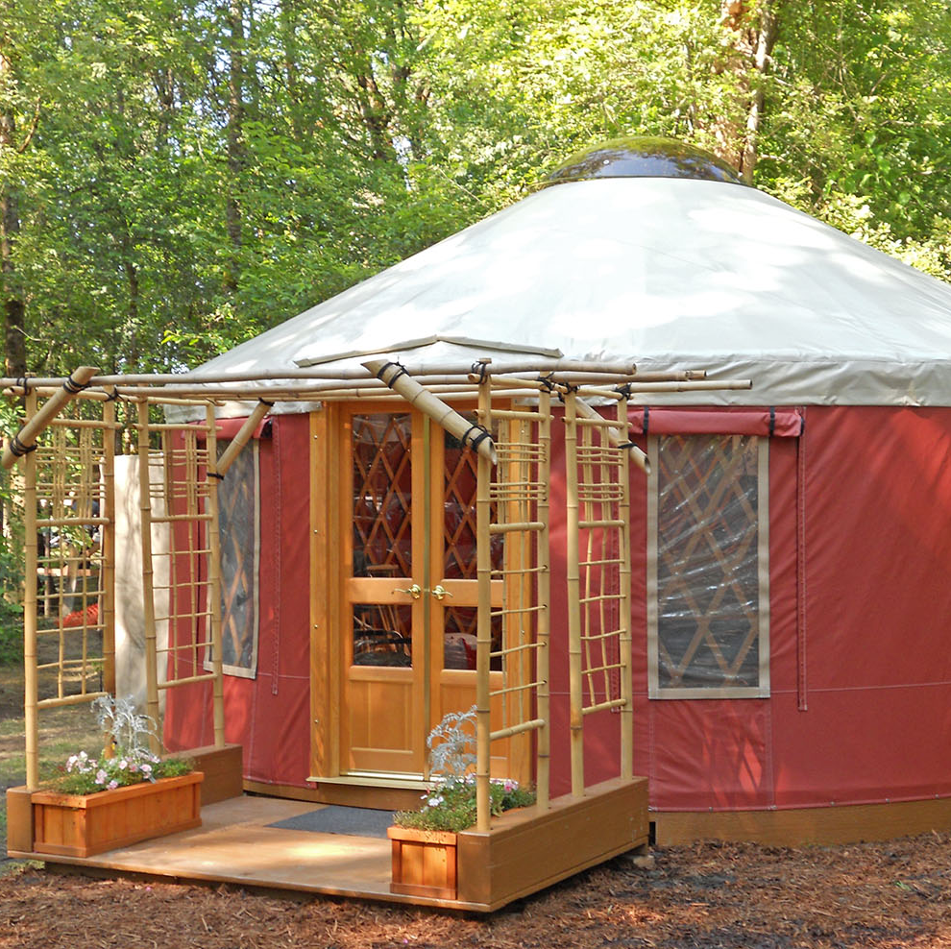
Yurt Renovation
Repairs:
Passive Solar heated floor
Interior lighting
Windows
Additional furnishing:
Dining/study table
Projector/sound system
Improved wifi

Slide 11
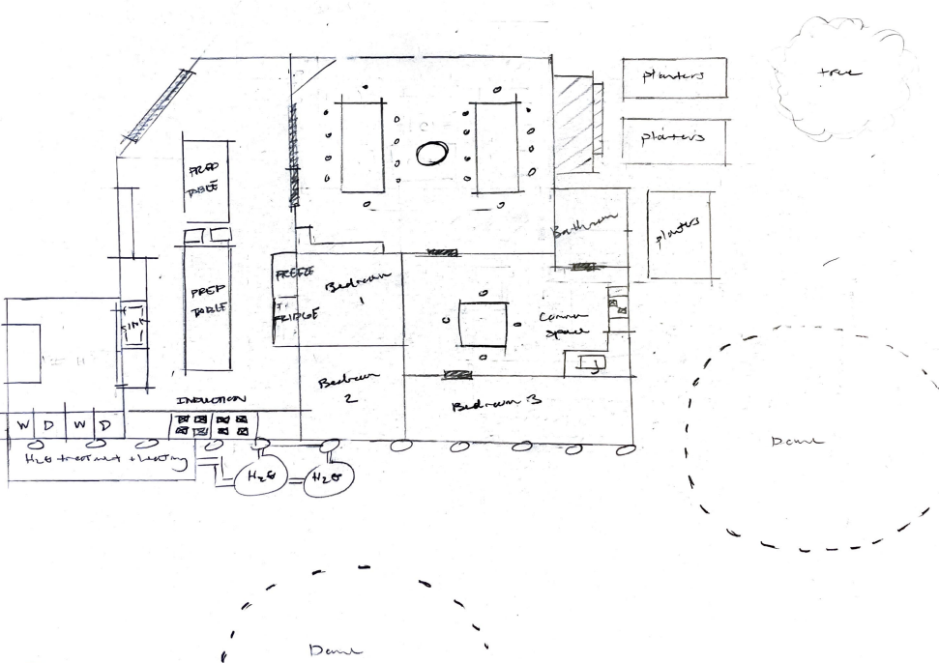
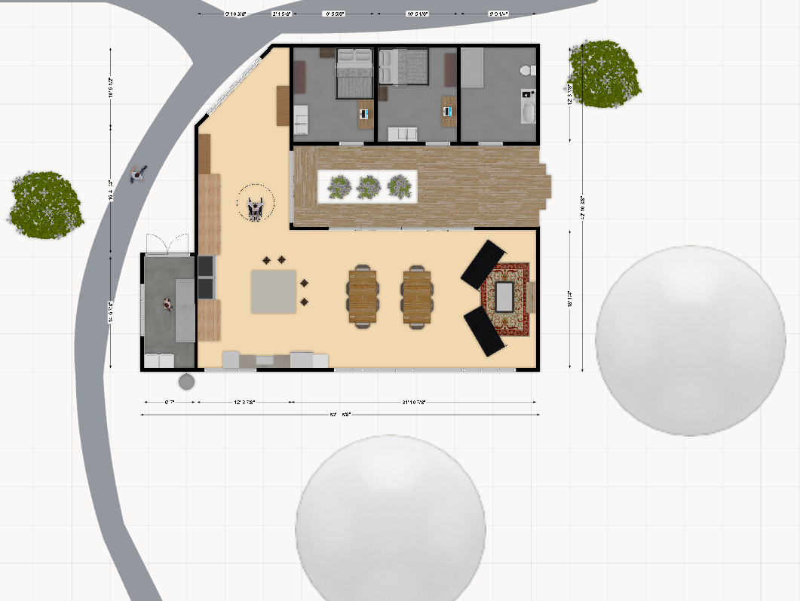
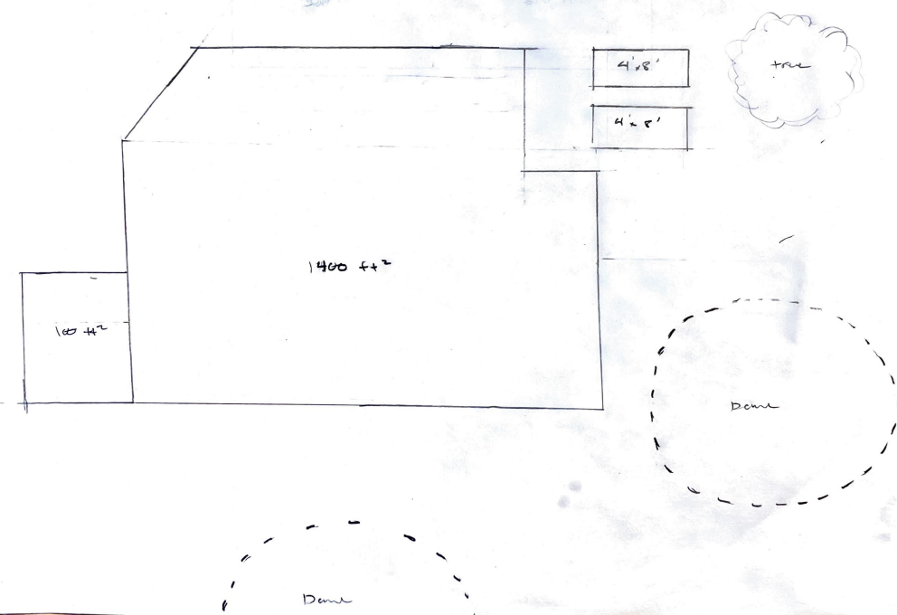
Herb House
Electrical tie-in + battery

Slide 12
Concept Evaluation
Herb Hall Kitchen
Herb Complex
Need: Provides essential services and incorporates design elements with high need ranking =>3
Community Engagement: design incorporates many elements that promote interaction and cooperative living (bar, dining areas, stage for entertainment). More open space design
Sustainability: (simplified) rainwater capture and waste-water systems, solar panels, and upcycled materials. not as much passive heating and cooling. Garden is better
Functionality: provides essentially the same services as more complex design
Feasibility: construction is relatively simple and outdoor spaces are not as constrained by building code.
Cost: low cost
Need: Provides essential services and incorporates all design elements with need ranking =>2.
Community Engagement: Design has fewer elements that promote interaction and space is more sectioned
Sustainability: (more complex) rainwater capture and waste-water systems, solar panels, and upcycled materials. Passive heating and cooling included in main dining/meeting space
Functionality: Provides the same services as less complex design but includes supplemental housing units and a bathroom
Feasibility: More constrained by building code (housing units) and construction will require contractor
Cost: high cost
Notes:
Herb hall scores higher in Community engagement,, feasibility and cost. Herb complex scores higher in need, sustainability, and functionality

Slide 13
Diversity, Equity and Inclusion
Diversity: Shared community spaces allow individuals of different backgrounds and perspectives to interact and cultivate mutual respect and understanding
Inclusion: Our design places emphasis on accessibility, both mobility and sensory disabilities
Equity: A shared kitchen provides Domies with equal opportunity to engage in communal gathering and meal sharing to support community building

Slide 14
Recommendations
Avenues for cost reduction
Upcycle materials on site
Yolo County Landfill Reuse store
Community markets / secondhand stores
Aggie Surplus
Donation drive / fundraising events
Federal / state rebate programs / incentives
Community empowerment
Site planning and construction workshops
Gardening, food processing, and systems maintenance / design workshops
Notes:
Reusing materials on site - wood, tile, stones
Donation Drive
Yolo County Landfill Reuse store
Community markets - Facebook Marketplace, Craigslist
Community nonprofits - Yolo Thrift Store, Community Mercantile
Campus services – Aggie Surplus, Campus Planning Storm Trees?

Slide 15
Next steps
Internal design review and concept revision
Get quotes for construction costs
Solar sizing and system design
Water catchment PID and system layout
External design review (EHS / UCD DCM)
Develop fundraising strategy
Apply for grant funding

