Slide 1
Modeling ZNE Consumption Targets
Prepared by: Lucas Beslow, Leslie Nelson, Taher Othman
Project client: Dr. Angela Sanguinetti

Slide 2
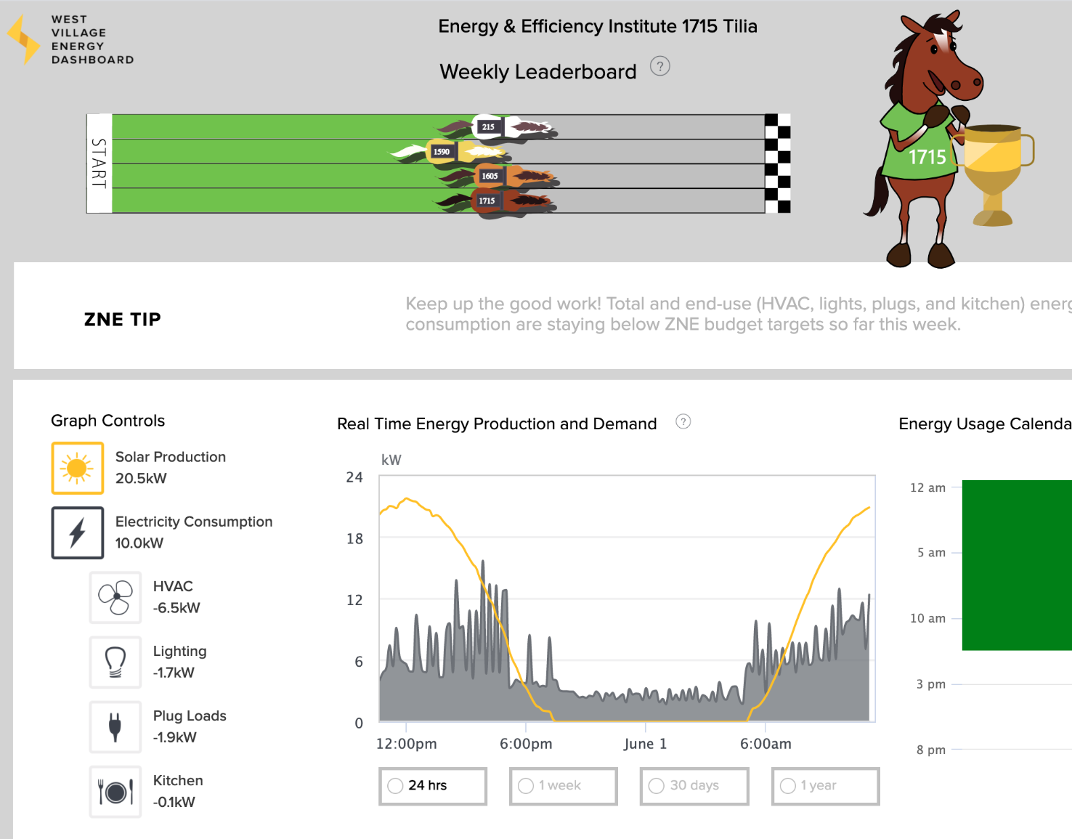
Problem Statement
There is an existing model for the West Village commercial buildings that gives ZNE energy budgets for each buildings’ end uses
We were tasked with producing a more accurate model that would provide dynamic energy budgets per end use
Photo: http://wved.ucdavis.edu/#!/
Notes:
Based on previous years’ data- assumes constant energy usage and production year-to-year
Lacks any dynamic inputs, and does not consider the effects of weather or occupancy on energy usage, limiting its accuracy

Slide 3
Methodology
Conduct Literature Review
Found that outdoor air temperature and occupancy are powerful predictors of building energy use
Linear regression can be an accurate method for modeling this relationship, even more so than leading building energy modeling software
Build Model
Using weather inputs (heating and cooling degree days) as well as occupancy indicators (weekend, holiday, school in session)
Model Validation
Compare the mean-squared error of the old model vs. new model to determine if improvements were made
Icons: https://thenounproject.com/

Slide 4
Tools and Procedure
5. Code final model logic
1. Data Cleaning
3. Linear regression
2. Incorporate weather data
4. Evaluate Model
Notes:
Used different tools based on data availability and team members’ comfortability with each software

Slide 5
General Overview of Model
Generate linear regression equation to predict end use daily budget %
Calculate cooling degree days and heating degree days
Find hourly end use budget
Include occupancy indicators for each day
Calculate average daily budget from PV
Icons: https://thenounproject.com/
Notes:
Calculate cooling degree days and heating degree days using predicted and actual hourly temperature data
Hourly temperature predictions for the week using hyperlocal temperature data from Dark Sky
Hourly temperature actuals for all weeks prior in that year using historical temperature data
Occupancy indicators gives us weekdays versus weekends (just make sure which one uses previous data from years)
Days classified as weekend, holiday, and school day or not
Annual PV production = building overall budget
Divide annual budget by 365 to get average daily budget
Calculate daily budget for each end use

Slide 6
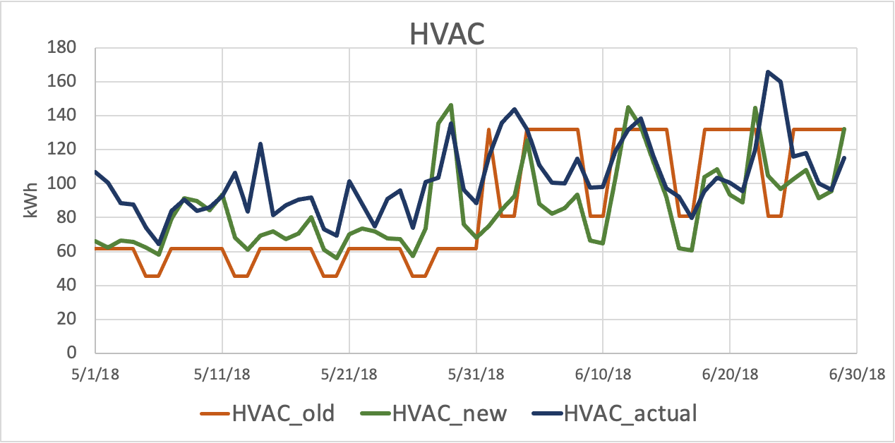
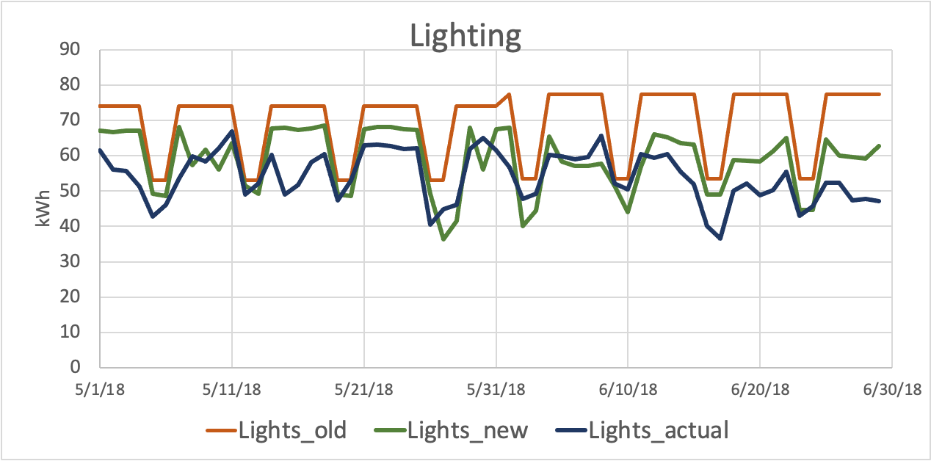
Is the new model better than the old?
Mean Square Error
Old HVAC | 1220
New HVAC | 627
YES!
Mean Square Error
Old Lights | 303
New Lights | 70

Slide 7
How can it be improved?
Inspect metered data input more thoroughly to clean out all noise affecting the results
Include more historical data to improve energy use predictions and to better capture seasonality
Conduct energy audits to ensure an equitable division of PV budgets among buildings depending on need

Slide 8
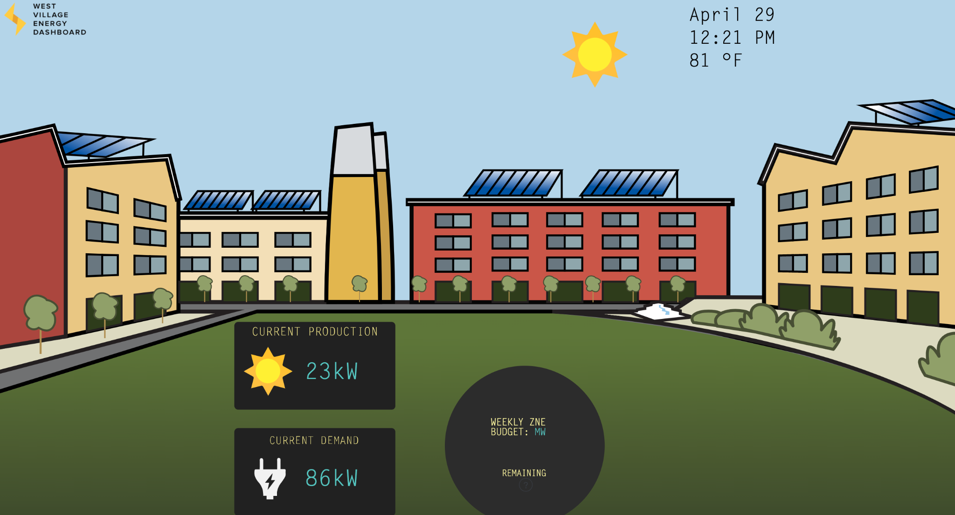
Next steps for client
Review the model logic and provide any feedback
Clean the data for the other 3 buildings and include in the model
Build APIs to connect dashboard to Dark Sky weather predictions and PI database historical weather data
Photo: http://wved.ucdavis.edu/#!/

Slide 9
Acknowledgements
We would like to thank our client, Dr. Angela Sanguinetti, and her team, including David & Nathan, for all their insight and support during the development of our project.
We would also like to thank Dan Colvin for his guidance and valuable advice throughout our project.

Slide 10
Thank you!
Please feel free to ask any questions!

