Slide 1
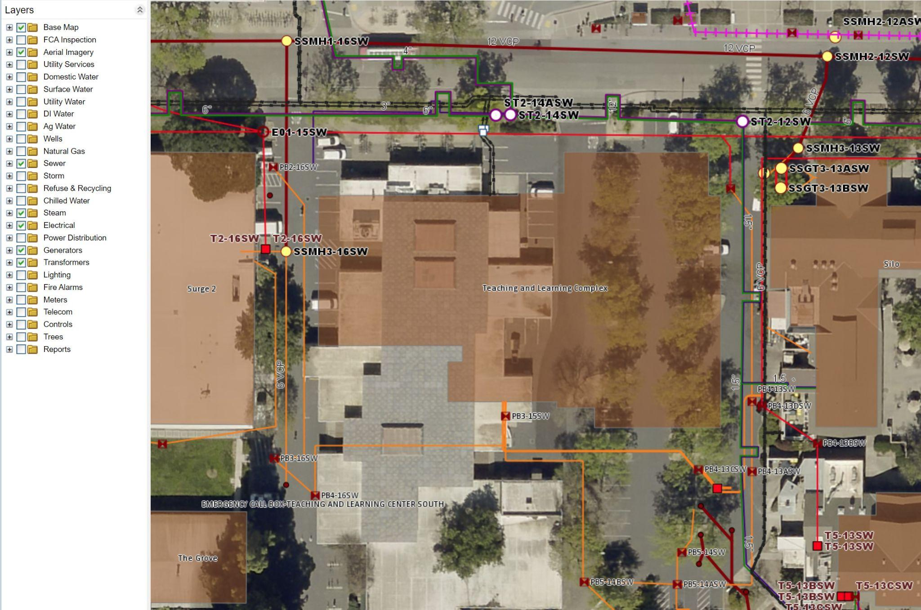
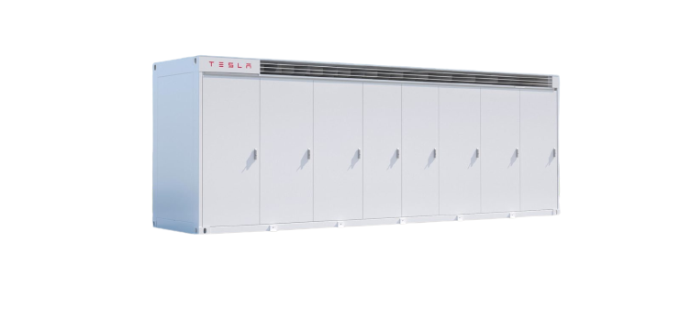
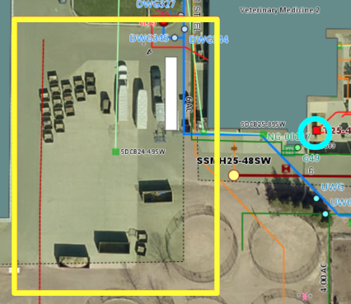
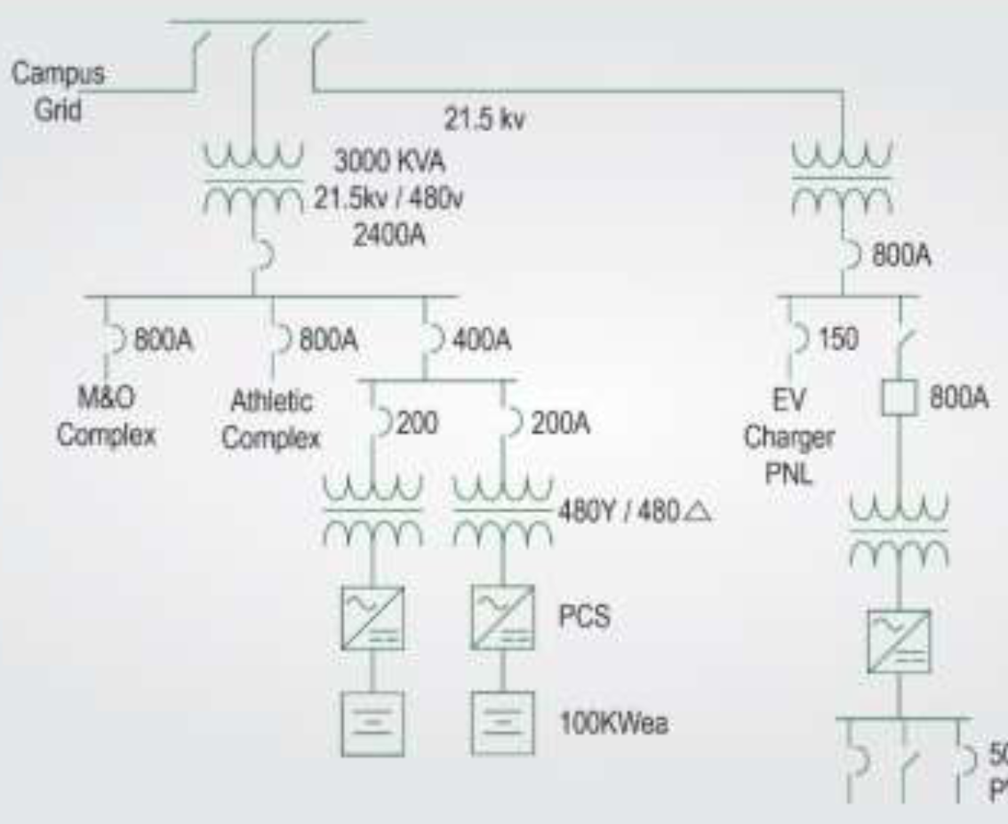
Considerations for Battery Energy Storage System Implementation on UC Davis Campus
Brenna Gracely, Chanthal Trejo-Landa, and William Evans
Client: Thomas Patten & UC Davis Utilities
Path to Zero Net Energy (ABT 212) Spring 2023
Introduction
Site Selection Process
Considerations for UCD BESS
UC Davis received funding from the California Public Utilities Commission to install a 3 MWh battery energy storage system (BESS) for the purpose of load-shifting. The client is curious about if more BESS should be added to campus, where those future systems should be located, and what considerations should be made. To answer these questions, our team was asked to find out how other college campuses have integrated BESS and to determine and justify at least three suitable sites on campus.
Find 480V(3Ø AC) at 1000 kVA+ transformer
Locate building associated with transformer
Confirm buildings served
Avoids underground utilities?
Is there enough physical space?
Investigate building load
Calculate remaining availability
Incorporating Equity
Involve Relevant Stakeholders
Consider employing underrepresented workers for site installation and maintenance
Installation
Utilize existing infrastructure where possible
International component shortages
Dramatic impact on project cost & timeline
CEC Energy Code 2022 Title 24 {6.1, 140.10} requires schools to have installed storage & solar for new projects > 5000 sqft
Operational Scheme
Real time pricing & CO2 signals
Demand Response
Transformer load monitoring
One Line Diagram
Campus Map
Facilities Map
YES
PI Vision
Nameplate kVA - Building Load > 500 kVA
Good Site
Transformers
Utility lines
Electricity demand
Order of Preference:
1) One building for a transformer
2) Several buildings for a transformer
3) Building(s) served by multiple transformers
If no space for BESS, then transformer cannot be considered
If not enough availability, then transformer cannot be considered
Application: Load shifting
If underground utilities present, then further investigation is needed
Economic Viability
Load shifting
Student Health & Wellness Center
Center for Companion Animal Health
Contained Research Facility
Demand Response
Bid to CAISO as a Spinning Reserve (> 500kW)
Vital in recouping CAPEX
Demand Response Auction Mechanism (DRAM)
UCSD generated $96,025 in July/Aug 2020
Simple Payback Period < 10 years
Targeting Grants
Utilize government incentives
(CA) SB 700 (2018) created SGIP
SGIP authorized $1B in funding through 2024
Equity Category = $850/kWh
Equity Resilience Category = $1000/kWh
Customer demand
Time
Time
Time
[1]
[3]
Load shifting moves the electricity demand from one time to another utilizing storage systems. If demand is shifted to when electricity prices are lower, utility bills decrease.
Site Constraints
800 kVA available
1100 kVA available
900 kVA available
Literature Review: Other college campuses
Transformer
Voltage: 480 V (3Ø AC)
Power: 1000 kVA +
Location
Avoid underground utilities
Enough physical space
Building Load
Electrical demand of served building
Max kW over a year
UC San Diego
Las Positas Community College, Livermore, CA
Future Work
Simple payback period: 5.6 years
Purpose: Campus-wide demand charge mitigation
Installation: directly to the 12 kV campus grid
Purpose: Campus-wide demand charge mitigation
Installation: switchboard shared with athletic field lights
Report detailing findings and recommendations
UCD specific techno-economic analysis
Consideration of switchgear sizing
Continuous student involvement in BESS
350 ton Absorption Chiller
Campus grid
21.5 kV
3000 kVA
21.5kV / 480V
2400 A
Acknowledgments
2.5MW / 5MWh BESS
800A
Special thanks to Tom Patten and the ABT 212 teaching team for their support and guidance.
Current BESS installment site
800A
800A
400A
EV Charge PNL
150
800A
2.8 MW Fuel Cell
M&O Complex
Athletic field lights
200
200A
References
Animal Husbandry Feed-mill
480Y / 480Δ
Transformer size: 1000 kVA
Peak load: 437.5 kVA
Underground utilities: None
Physical space: gravel lot, plenty of space
[1] M. Ismail, I. S. Bayram, K. Qaraqe, and E. Serpedin, “5G‐Enhanced Smart Grid Services,” 2019, pp. 28–102. doi: 10.1002/9781119515579.ch4.
[2] B. Rich, “Making a Microgrid From Legacy Systems: Las Positas College Microgrid,” California Energy Commission: Energy Research and Development, CEC-500-2019-052, Jul. 2019. [Online]. Available: https://www.energy.ca.gov/publications/2019/making-microgrid-legacy-systems-las-positas-college-microgrid
[3] J. Dilliot, “Questions about UC San Diego battery energy storage,” May 23, 2023.
200 kW BESS
500 kW PV array
[3]
[2]

