Slide 1
Electrifying UC Davis Light Duty Fleet
By: Jonathan Boyd
Oleksandr Syrovoi
Julia Hoffman
Notes:
Instructions: 7-8 min total (10 min max), be creative, scored on: quality of presentation (clarity, organization and citations), methodology/analysis, and results, discussion and recommendation

Slide 2
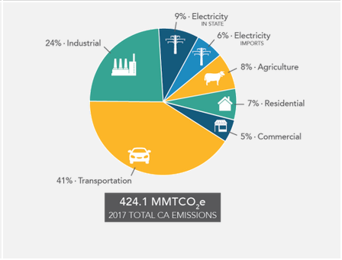
Phasing out Fossil Fuels
UC goal to be Carbon Neutral by 2025
Scope 1 emissions include transportation services
Reduce emissions through electrification
https://ww2.arb.ca.gov/ghg-inventory-data
Notes:
Governments, individuals and organizations are working to reduce their fossil fuel consumption. The UC system has pledged to be carbon neutral by 2025. One way they are working towards reducing emissions is through direct, scope 1 emissions, caused by transportation services. The goal is to reduce GHG emissions through electrification opportunities such as in campus fleet. In the pie chart you can see that 41% of emissions in CA are from transportation. This signifies that there is a lot of room for improvement and a need to reduce.
https://ww2.arb.ca.gov/ghg-inventory-data
States, organizations, and universities are setting pledges to reduce carbon dependencies
AB 32: California’s goal to decrease GHG emissions to 1990 levels by 2020
The University of California has pledged to be carbon neutral by 2025
UC Davis 2009-2010 Climate Action Plan
In coordination with California GHG goals
“Achieve climate neutrality as soon as feasible”
Anon. 2018. University of California Strategies for Decarbonization: Replacing Natural Gas TomKat Natural Gas Exit Strategies Working Group Report to the TomKat Foundation. http://doi.org/10.17605/OSF.IO/HNPUJ.
Anon. UC Davis 09-10 Climate Action Plan.

Slide 3
What makes our calculator different?
No loans or interest
No insurance costs
Considerations for Davis specific energy grid
Calculates TCO & GHG emissions in one place
Automatically applies to 9 year life span
Impacts of idling
Notes:
Applicable to all three uses of campus fleet: departmental rental, daily rental, and UC Drive: hourly rental
No loans or interest
No insurance costs
Considerations for Davis specific energy grid
Calculates TCO & GHG emissions in one place
Automatically applies to 9 year life span
Impacts of idling
Department rental: department rents a car long term for their use only, usually these vehicles are parked by the department
Daily rental: this is for both employees and students, Can be used for research or sports teams etc
UC Drive: hourly rental, Works like zip car

Slide 4
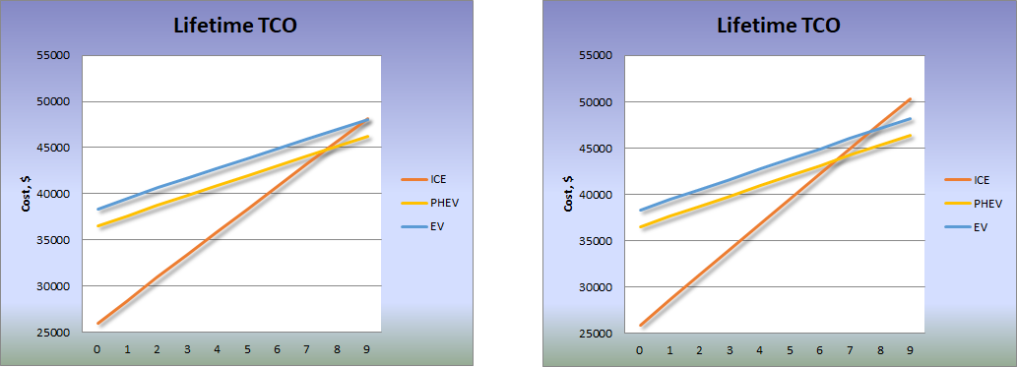
Zero-emission on short trips
Idling Impact Over Lifetime
No Idling
2-hour idling a day
Notes:
Distinct feature of our tool is factoring in idling. We analysed impact idling has on the results and it appears that conventional vehicles are quite sensitive to idling time to the point that if vehicle idles extensively (like facility vehicles do) TCO ends up being significantly higher than EV and PHEV, even without accounting for incentives

Slide 5
Key Assumptions
Constant power and gas prices
Constant GHG intensity
Month trip data can be extrapolated over a year
Discrete fuel consumption (CMPG/HMPG)
45% highway for short trips (<50 mi)
80% highway for long trips (>50 mi)
Charges per trip
1 charge for short trips (<200 mi)
1.5 for long trips (>200 mi)
Notes:
-touch on uncertainty

Slide 6
Critical Vehicle Inputs
MSRP
Trip data (real world use data)
Trip Distance
Idle Time
EPA Estimation of MPG (MPGe)
Notes:
This isn’t all inputs but these are the inputs relevant to each vehicle

Slide 7
Outputs
Tool produces output for each vehicle comparison:
Total Lifetime Cost of Vehicle
Total Lifetime Emissions, UC Davis Power, [lb GHG]

Slide 8
Case Study 1
2019 Chevrolet Volt
2020 Chevrolet Bolt EV

Slide 9
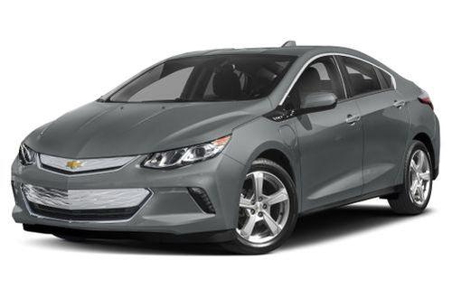
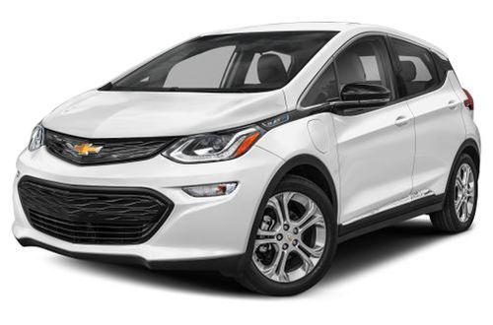
Key Differences
2019 Chevrolet Volt (PHEV)
MSRP = $34,095
TCO = $42,737
39,622 lb GHG
2020 Chevrolet Bolt (EV)
MSRP = $37,495
TC0 = $41,051
2,109 lb GHG
https://www.cars.com/research/compare/?vehicles=chevrolet-bolt_ev-2020,chevrolet-volt-2019
https://www.cars.com/research/compare/?vehicles=chevrolet-bolt_ev-2020,chevrolet-volt-2019
Notes:
This was about most straightforward comparison. We chose to evaluate the 2019 Volt, a car that campus already owns, and a likely comparison, the 2020 electric Bolt
While the bolt is just minimally cheaper, when looking at the TCO, if tax incentives are applied…(look into this specifically)
The Bolt results in just over 5% (5.3228%) GHG emissions compared to the Volt
20% of energy consumption was due to idling so has a large impact
90% GHG reduction of Bolt emissions using UC Davis Grid
Image: https://www.cars.com/research/compare/?vehicles=chevrolet-bolt_ev-2020,chevrolet-volt-2019

Slide 10
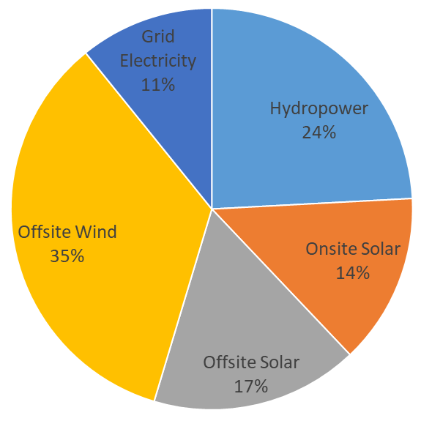
Significant Progress on University Electricity Mix
UC Davis Grid Emissions
2,109 lb GHG
CA Grid Emissions
19,365 lb GHG
https://www.cars.com/research/compare/?vehicles=chevrolet-bolt_ev-2020,chevrolet-volt-2019
Notes:
UC Davis has made significant progress to decarbonize its electrical supply, with 89% of total generation coming from low-carbon sources in difference from State grid, which is still over half is fossil-based. That presents University a remarkable opportunity to decarbonize its light-duty fleet via electrification

Slide 11
Case Study 2
RAV4 2020 Conventional
RAV4 Prime 2021
Hyundai Kona Electric
Notes:
The second case study we evaluated was between the 2020 Conventional RAV4, the 2021 RAV4 Prime, and the Hyundai Kona Electric

Slide 12
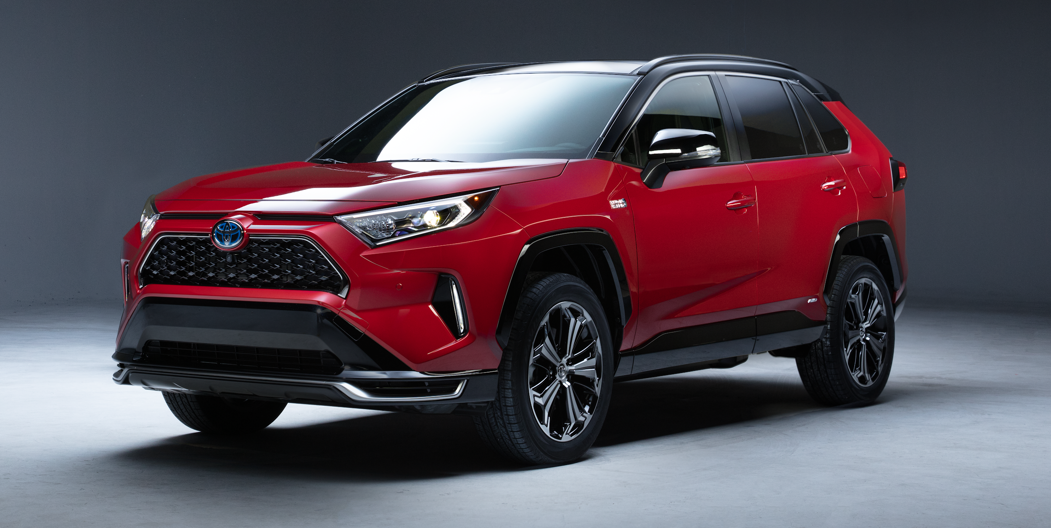
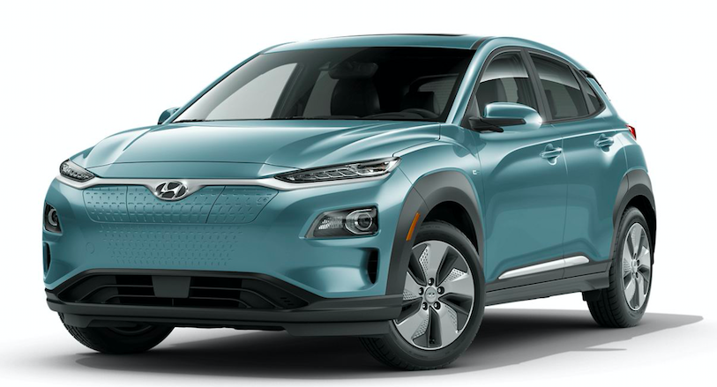
Key Differences
RAV4 2020 Conventional
Current UC Davis vehicle
All electric range = 0 mi
RAV4 Prime 2021
Future vehicle option, PHEV
All electric range = 39 mi
Hyundai Kona Electric 2020
Current Electric alternative
All electric range = 258 mi
https://www.toyota.com/rav4/?srchid=sea:Model_RAV4_SET_US:GOOGLE:Toyota_RAV4_Gallery_Ads_EXACT::&gclsrc=aw.ds&&gclid=CjwKCAjwztL2BRATEiwAvnALcniOBdSv5AwOo6kn97cWucEMyoT3cMoNfsAI8bufvljZs9sxxWPqaRoC5H0QAvD_BwE&gclsrc=aw.ds
https://pressroom.toyota.com/toyota-revs-up-lineup-with-new-302-horsepower-rav4-prime/
https://www.hyundaiusa.com/us/en/build/#/368
Notes:
We are comparing the 2020 Conventional RAV4 as campus currently owns and has data on it. The RAV4 Prime is a soon to be released, PHEV alternative, and the Hyundai Kona is a comparable electric alternative to the conventional RAV 4.
One key difference is the range of the vehicles. While the average daily travel for this vehicle group is extremely manageable, this car is sometimes used for longer distanced trips.
October data from fleet showed that 4 of the 9 trips taken by the Conventional RAV4 exceeded the range of the Kona. This can be adjusted for by stopping for a quick charge or moving those trips to current fleet vehicles with greater range.
The range is 258 mi but the additional trips mileage is 277.8, 60 days per year? (that just over 15% of the days per year)
Toyota RAV4: https://www.toyota.com/rav4/?srchid=sea:Model_RAV4_SET_US:GOOGLE:Toyota_RAV4_Gallery_Ads_EXACT::&gclsrc=aw.ds&&gclid=CjwKCAjwztL2BRATEiwAvnALcniOBdSv5AwOo6kn97cWucEMyoT3cMoNfsAI8bufvljZs9sxxWPqaRoC5H0QAvD_BwE&gclsrc=aw.ds
RAV4 Prime: https://pressroom.toyota.com/toyota-revs-up-lineup-with-new-302-horsepower-rav4-prime/
Hyundai Kona Electric 2020: https://www.hyundaiusa.com/us/en/build/#/368

Slide 13
RAV4 2020 Conventional
$45,786.75
112,209 lb GHG
RAV4 Prime 2021
$51,511.75
73,060 lb GHG
Hyundai Kona Electric 2020
$44,598.71
2,924 lb GHG
Results
Notes:
Here you can see the Total Cost of Ownership and the GHG emissions from each vehicle. The Hyundai Kona 2020, the electric vehicle of the bunch proved to be the least expensive and drastically lowered GHG emissions.
Considering both categories, the electric vehicle, the Hyundai Kona, is the one we would recommend.

Slide 14
Case Study 3
2020 Chrysler Pacifica
2020 Chrysler Pacifica PHEV
Notes:
Our final comparison is between the 2020 Chrysler Pacifica and the 2020 Chrysler Pacifica PHEV
We chose these as an example for campus mini vans

Slide 15
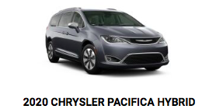
Key Differences
2020 Chrysler Pacifica
Lower MSRP cost
TCO = $39,990
42,958 lb GHG
2020 Chrysler Pacifica PHEV
TC0 = $45,312
21,171 lb GHG
https://www.chrysler.com/pacifica/hybrid.html
https://www.chrysler.com/pacifica/hybrid.html
Notes:
The Chrysler Pacifica begins with a lower MSRP and after inputting related campus fleet data, it was still the cheaper option (the PHEV MSRP is $8,500 more than the regular vehicle)
This was in part due to the low daily mileage on this type of vehicle.
Campus vans only drive an average of 20 miles per day, and are used half the days in a week. The regular Pacifica cost $0.05 more per mile than the plug in. (If the annual distance traveled for this vehicle increased, the PHEV may become the cheaper option.)
Even with low daily mileage, the PHEV results in lower than 50% GHG emissions compared to the regular vehicle.
Lastly, federal and state tax credits can greatly reduce the cost of the PHEV. If the $7,500 federal tax credit and the $1000 state tax credit were applied, the PHEV would become cheaper than the regular pacifica. (becoming $36,812).
Currently there is a federal tax credit of $7,500 for the Chrysler Pacifica PHEV, in addition to a $1000 state tax credit so that would reduce the cost to lower than the regular one.
While the cost per mile of the PHEV is $0.12, the cost per mile of the regular vehicle is $0.17.
In this case, we would recommend that fleet may consider comparing a few other models, in hopes of finding a cheaper alternative that matches the GHG benefits of this PHEV.
Image: https://www.chrysler.com/pacifica/hybrid.html

Slide 16
Key findings
UC Davis in perfect position to electrify its fleet
Idling is a factor in TCO and GHG reduction
Proposed framework has a potential opportunity to be applied to other universities
Notes:
Given UC Davis impressively green electricity mix, transportation electrification offers a very efficient GHG emission reduction lever
Conventional vehicle idle reduction may lead to a substantial fuel use and emission reduction, subject to actual vehicle utilization
Framework developed may be utilized to evaluate university facilities and maintenance department light-duty fleet as there may be significant opportunities for idling reduction
-its worth calculating bc not always a good outcome

Slide 17
THANK YOU

Slide 18
References
Image: https://ww2.arb.ca.gov/ghg-inventory-data
Image: https://www.cars.com/research/compare/?vehicles=chevrolet-bolt_ev-2020,chevrolet-volt-2019
Image: https://www.chrysler.com/pacifica/hybrid.html
Image: https://www.toyota.com/rav4/?srchid=sea:Model_RAV4_SET_US:GOOGLE:Toyota_RAV4_Gallery_Ads_EXACT::&gclsrc=aw.ds&&gclid=CjwKCAjwztL2BRATEiwAvnALcniOBdSv5AwOo6kn97cWucEMyoT3cMoNfsAI8bufvljZs9sxxWPqaRoC5H0QAvD_BwE&gclsrc=aw.ds
Image: https://pressroom.toyota.com/toyota-revs-up-lineup-with-new-302-horsepower-rav4-prime/
Image: https://www.hyundaiusa.com/us/en/build/#/368
https://www.fueleconomy.gov/feg/taxevb.shtml
https://cleanvehiclerebate.org/eng
Anon. 2018. University of California Strategies for Decarbonization: Replacing Natural Gas TomKat Natural Gas Exit Strategies Working Group Report to the TomKat Foundation. http://doi.org/10.17605/OSF.IO/HNPUJ.
Notes:
To do: need to reference fleet data and everything in the excel doc

