Slide 1
Shields Library
Engagement Project
ABT 212 001 (ZNE)
Kristen Bush
Cheyanne Harris

Slide 2
Outline
Problem Definition & Objective
Context & Background
Priorities of Client
Methodology
Case Studies
Proposed Outreach Strategies
Recommendations for Future Work
Bibliography

Slide 3
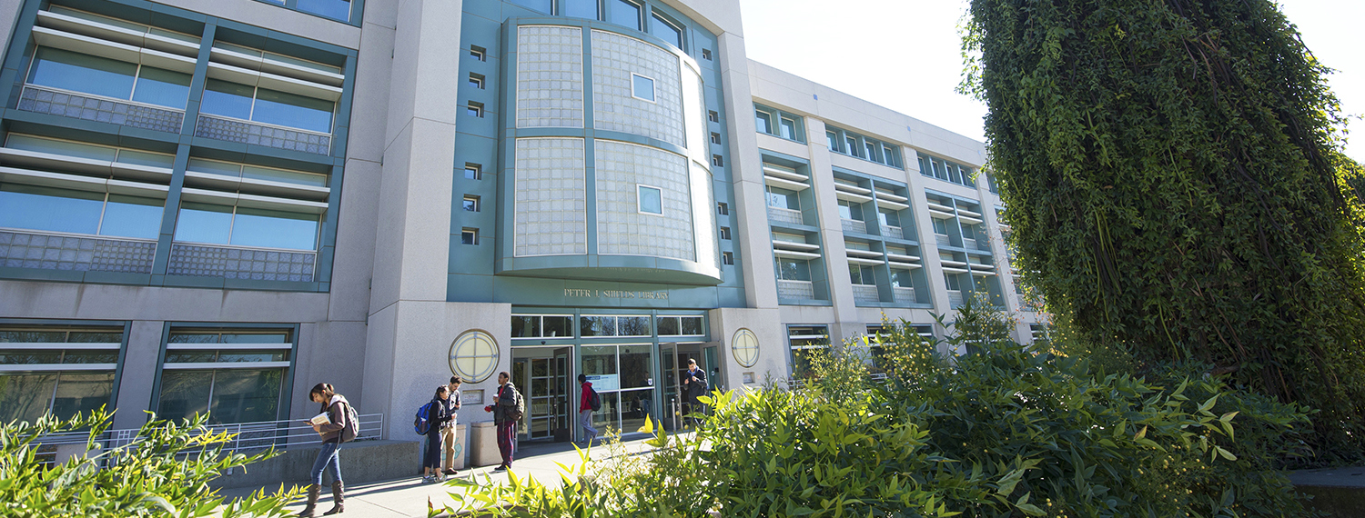
Problem Definition & Objective
Shields Library is undergoing a LEED certification process primarily through HVAC scheduling adjustments.
Educational Opportunities:
Energy Efficiency
Green Building Projects
Source: Robert Mondavi Institute - UC Davis
Problem Statement:
Communicating HVAC scheduling improvements through educational outreach opportunities.

Slide 4
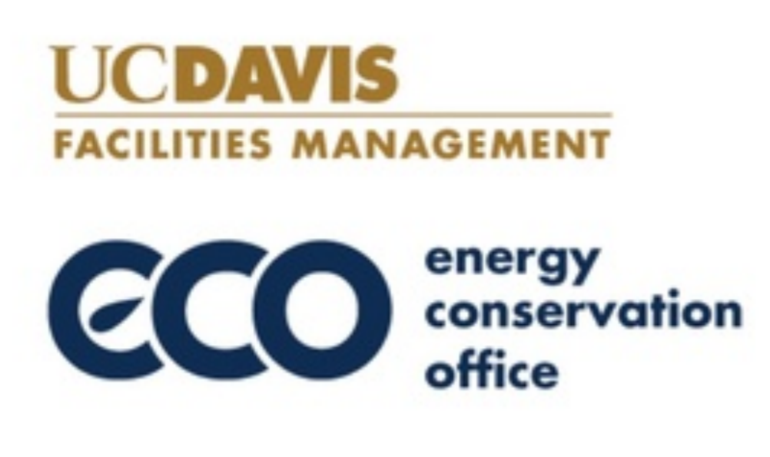
Problem Definition & Objective
Client: Energy Conservation Office (ECO)
Goals: Carbon Neutrality and Sustainable Stewardship
Priorities:
Education
Collaboration
Outreach/Promotion
Challenges:
Quantifying educational benefits
Creating community buy-in
Source: Energy Conservation Office

Slide 5
Methodology

Slide 6
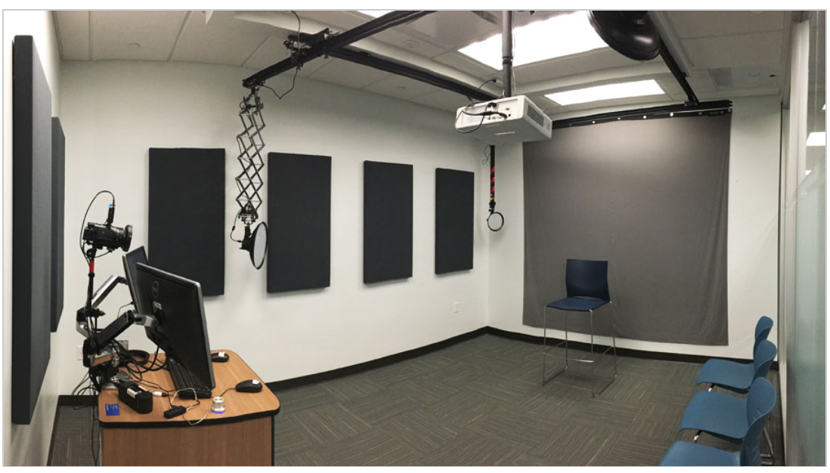
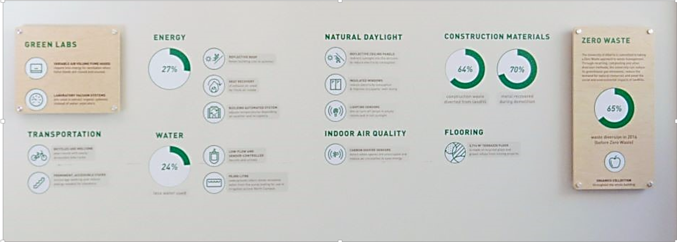
Case Studies
Source: University at Buffalo
Source: University of Alberta

Slide 7
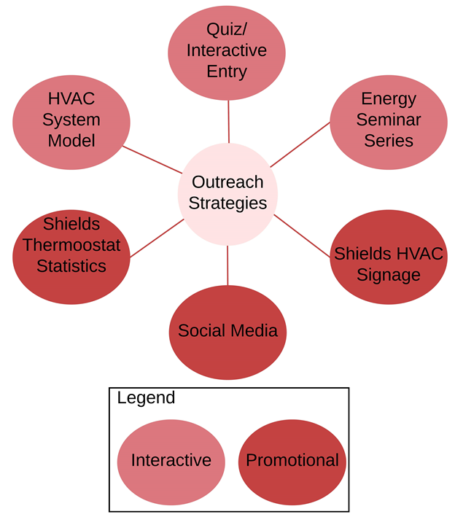
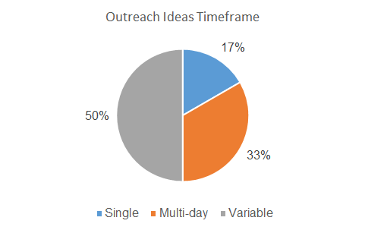
Proposed Outreach Strategies

Slide 8
Recommendations for Future Work

Slide 9
Takeaways
Collaboration
Education
Communicating to a non-technical audience
Source: Energy Conservation Office
Source: UC Davis Brand Guide

Slide 10
Bibliography
https://library.buffalo.edu/video-recording-studios/
https://www.ualberta.ca/index.html
UC Davis Brand Guide - https://ucdavis.app.box.com/v/wordmark-logos/folder/41541520782

