Slide 1
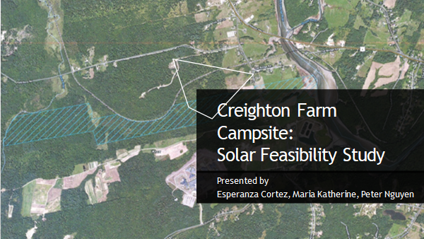
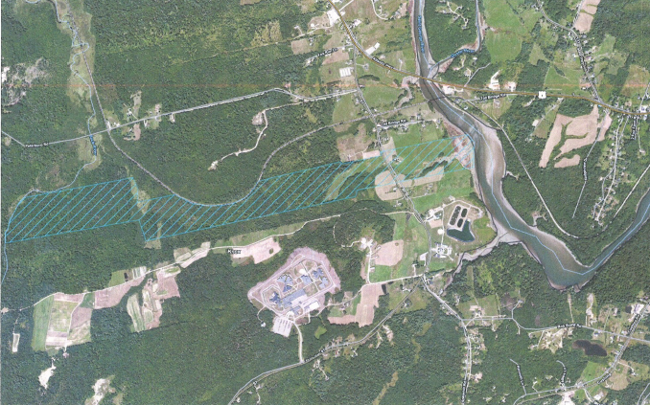
Creighton Farm Campsite:
Solar Feasibility Analysis
Presented by:
Esperanza Cortez
Maria Katherine
Peter Nguyen

Slide 2
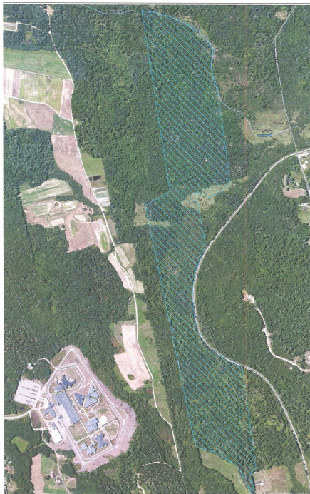
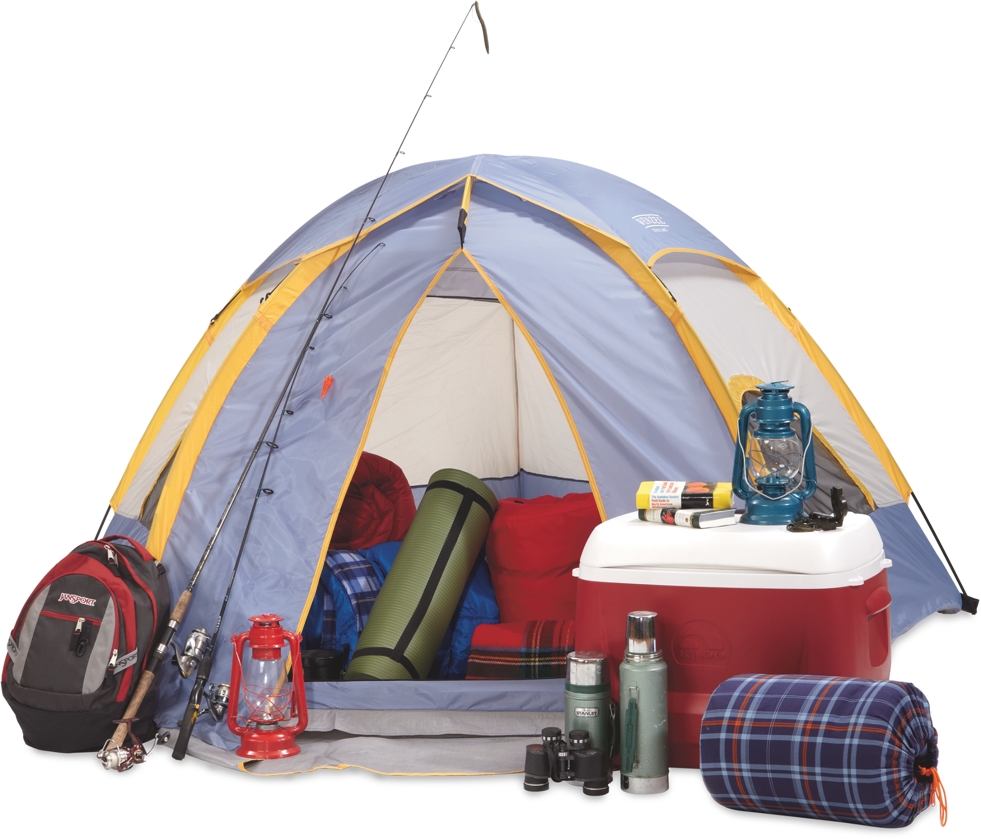
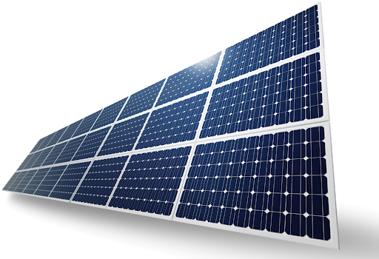
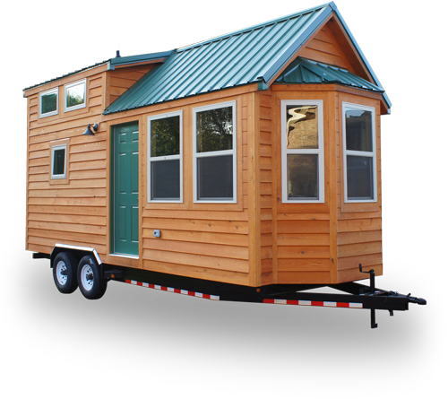
Background & Methodology
METHODOLOGY
Build a load profile
5 campsite facilities
4 tiny houses
6 RV parks
Solar Modeling Optimization Scenarios
Renewable Energy Fraction
Incentives
Next Steps
Creighton Farm
Figure 1. Map of Creighton Farm, a 236-acre land in Warren, Maine.
Notes:
SCOPE OF WORK
Load analysis
Solar Modelling
Best Practices

Slide 3
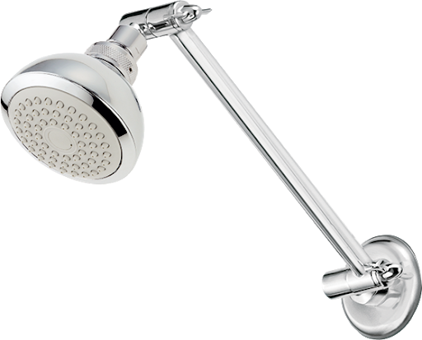
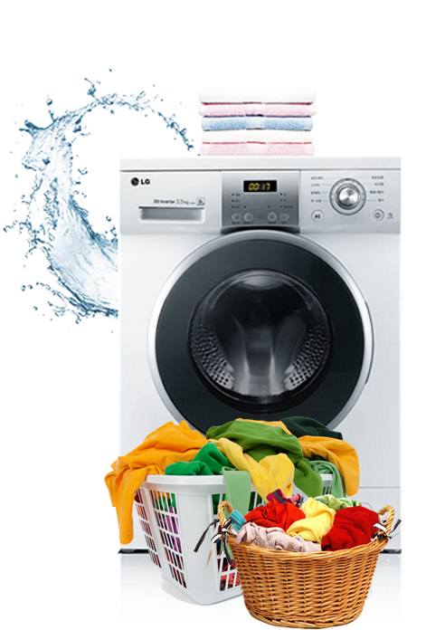
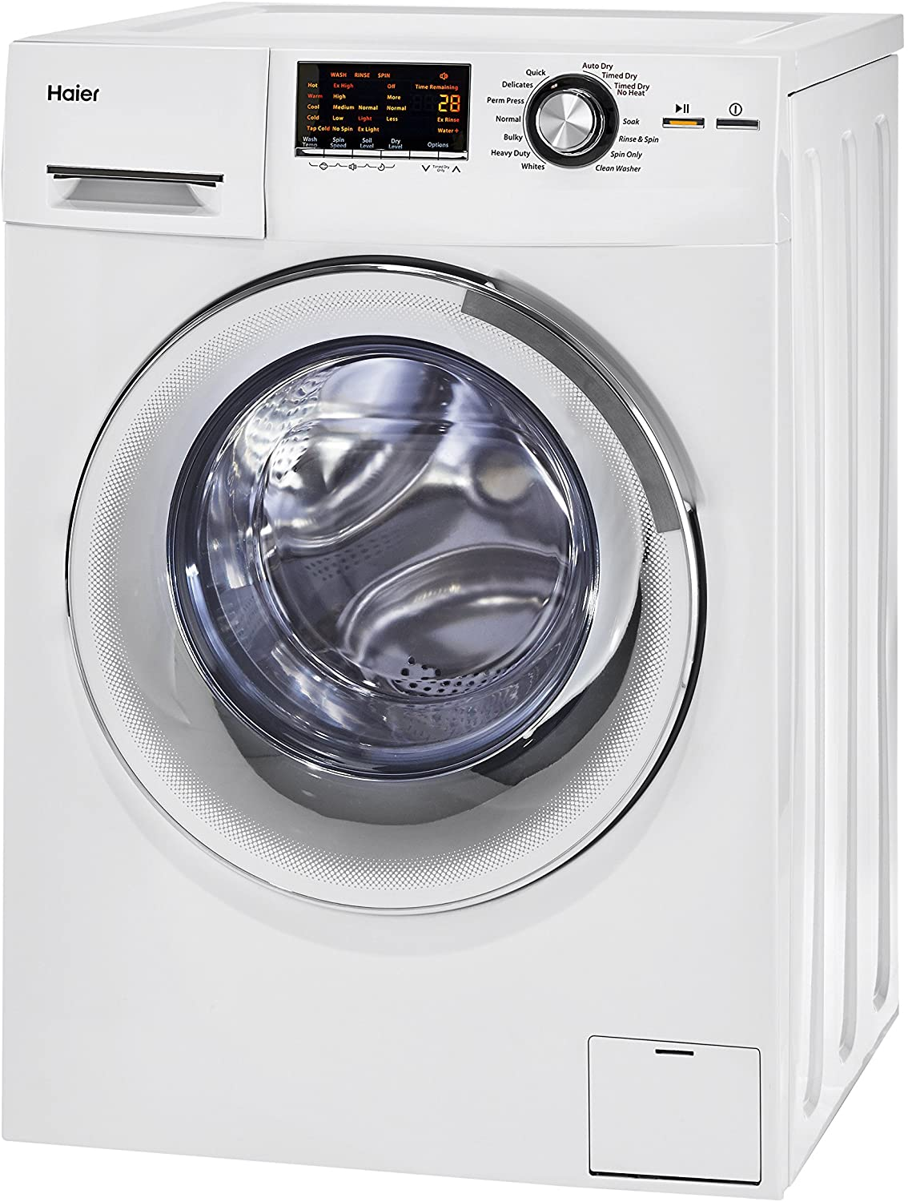
Determining the Electricity Load of Campsite Facilities
Facility | Number of Units | Assumptions | Annual Energy Demand
Showerheads* (Energy saving model, 2.2 gal / min) | 5 | (50 individuals x 5 minute shower x 270 days / year)* | 19,299 kWh
Laundry washer (4 ft³ Energy Star commercial model, IMEF = 2.55 ft³ / kWh / cycle) | 3 | (50 individuals x 1 cycle / 7 days x 270 days / year x 1.6 kWh / cycle) | 3,086 kWh
Laundry dryer (8 ft³ Energy Star residential model, Estimated 608 kWh / year for 283 cycles = 2.15 kWh / cycle) | 3 | (50 individuals x 1 cycle / 7 days x 270 days / year x 2.15 kWh / cycle) | 4,146 kWh
Total Annual Energy Demand for Campsite Facilities: 26,531 kWh
*Calculated using the Energy Cost Calculator for Showerheads and Faucets (energy.gov)
Notes:
We calculated the energy demand of showerheads, washers and dryers, including the energy it takes

Slide 4
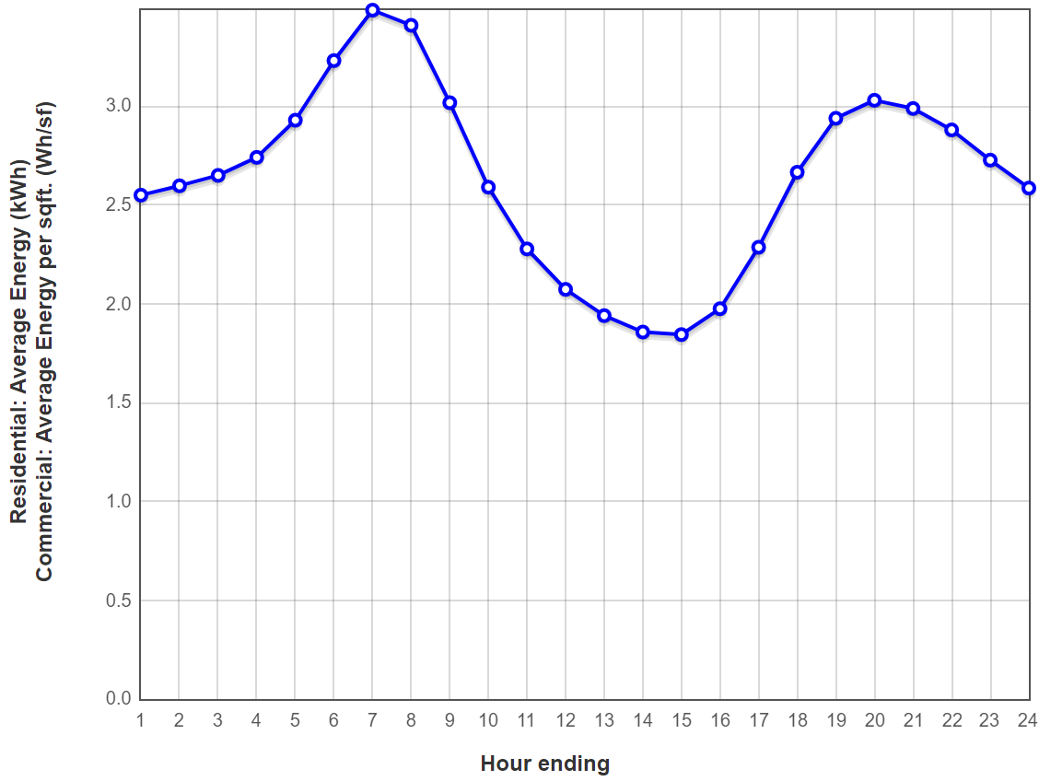
Determining the Electricity Load of Tiny Houses
Electric Power Research Institute (EPRI) data
Manufactured home
Electric heating
Concord, New Hampshire
CY 2001
Residential Energy Consumption Survey (RECS) data for the New England region
2001: 7,151 kWh / household
2015: 7,503 kWh / household
Figure 2. Average energy load profile for a manufactured home with electric heating in Concord, NH in 2001 (EPRI).

Slide 5
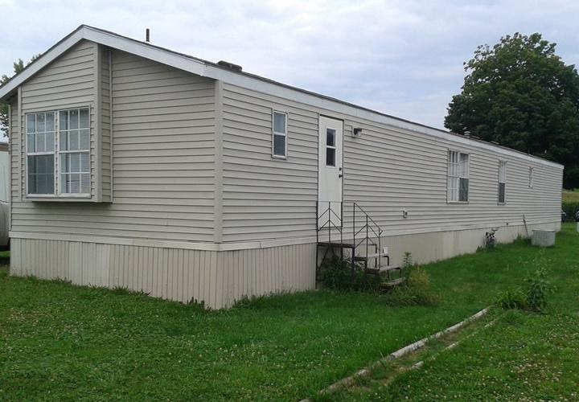
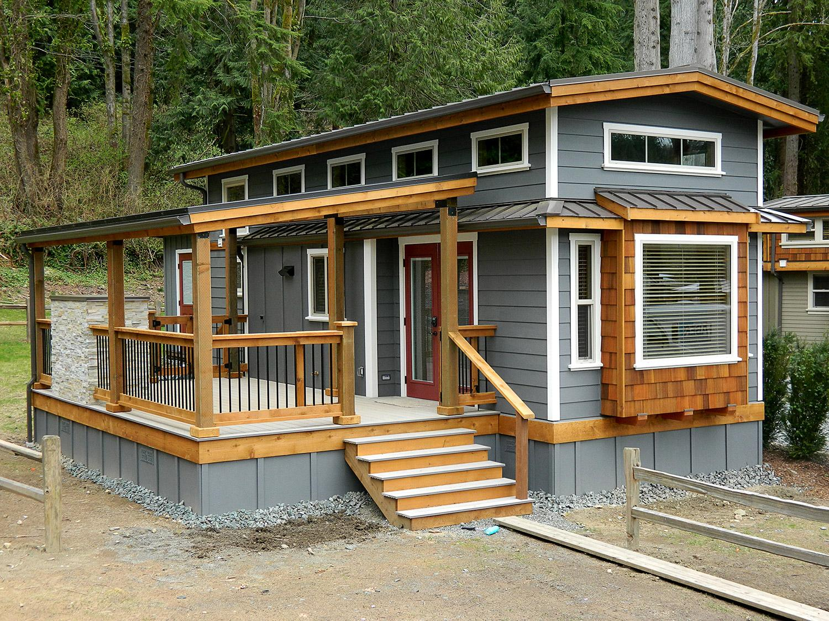
Determining the Electricity Load of Tiny Houses (continued)
Square footage data
Manufactured home: 1,440 sq. ft.
Tiny house: 400 sq. ft.
Total annual electricity load for a:
Tiny house with electric heating = 6,400 kWh / year
Typical Maine household with natural gas heating = 6,600 kWh / year
Figure 3. A 1,440 sq. ft. manufactured home (top) and a 400 sq. ft. tiny house (bottom).

Slide 6
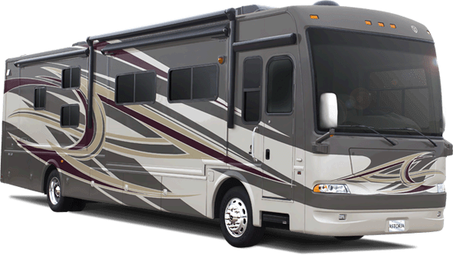
Determining the Electricity Load of an RV Park
Average Daily Load of an AC on all day
Daily load depends on:
Weather - Summer
15 minute cycles / hr in 24 hr
Central 24k BTU AC = 22.8 kWh / day
Electricity is not metered
Location (Year) | Energy (kWh)
Central PA (2010) | 12.5
Southern CA (2010) | 20.8
Average (2021) | 20
AC on all day | 40
AC off all day | 10
Source: Camper Grid (2021), GoDownSize (2021), A study of Sustainability at RV Parks (2006)
Notes:
RV parks normally don’t meter their camper. Individual metering of sites by park management is impractical at several levels. Unmetered electricity water, and sewage hookups.
$30k - 40k per month energy bills in large central california park
The owner of
a mid‐Atlantic park described a mid‐summer scenario with 40‐45’ big rigs running double ACs,
many with screen doors open due to RV neighborliness. Minimal vehicle insulation and high
degrees of leakage have made energy efficiency their casualty. RV refrigerators work only to 80%
of ambient temperature; but without effective insulation, fridges are working full tilt, even at night.
Shade trees, available in most Pennsylvania parks, partially offset the full sun, but in summers, “the
vehicles get blasted.

Slide 7
Total Average Energy Load
Number of Units | Description | Average Energy Demand per Unit (kWh / day) | Total Average Energy Demand (kWh / day)
6 | RV charging sites | 20 | 120
5 | Showers | 14.3 | 71.5
3 | Laundry washer | 3.8 | 11.4
3 | Laundry dryer | 5.1 | 15.4
4 | Tiny houses | 18 | 72
Estimated Total Average Energy Load = 290.3 kWh / day
Notes:
Marginal safety
Change monthly…

Slide 8
Optimizing Renewable Fraction Scenarios
Grid only
NPC: $213,793
COE: 15.8 ¢/kWh
Assumptions, Total Daily Load = 290 kWh
Renewable Fraction | 30% | 66.7% | 90%
Installed Costs ($ / W) | 3.00 | 3.00 | 3.00
Operating Cost ($ / year) | 13,571 | 14,616 | 27,310
Incentives | 0% | 0% | 0%
Solar Panel Capacity (kW) | 27.3 | 100 | 383
Initial Capital Cost ($) | 81,866 | 300,078 | 1,150,000
NPC ($) | 255,345 | 486,937 | 1,500,000
COE ($ / kWh) | 0.181 | 0.209 | 0.227
Assumptions
Results
Takeaway: Without incentives, the more renewables you use, the higher the cost but you get lower emissions. So a tradeoff between cost and emissions.
Notes:
Was not able to find the optimal system without Net Energy Billing Program
$15 for solar mounts
2.78 is the average solar panel

Slide 9
Optimizing Incentive Scenarios
Grid only
NPC: $213,793
COE: 15.8 ¢/kWh
Assumptions, Total Daily Load = 290 kWh
Renewable Fraction | 30% | 30% | 30% | 30%
Installed Costs ($ / W) | 3.00 | 3.00 | 3.00 | 3.00
Operating Cost ($ / year) | 13,571 | 13,571 | 13,571 | 13,571
Incentives | 26% (2021 - 2022) | 22% (2023) | 0% (2024 or later) | Net Energy Billing + 22% Tax Incentive
Solar Panel Capacity (kW) | 27.3 | 27.3 | 27.3 | 27.3
Initial Capital Cost ($) | 60,587 | 63,861 | 81,866 | 63,861
NPC ($) | 234,066 | 237,340 | 255,345 | 189,876
COE ($ / kWh) | 0.166 | 0.168 | 0.181 | 0.134
Assumptions
Results
Notes:
Was not able to find the optimal system without Net Energy Billing Program
$15 for solar mounts
2.78 is the average solar panel

Slide 10
Recommendations for Future Work
Consider Resources to Offset the Cost of Solar
Contact list of solar project sponsors in Maine, Power Purchase Agreements (PPA)
Contact Central Maine Power for Net Energy Billing Program
Apply for grants and incentives
Rural Energy for America Program: Federal Loans and Grants to fund renewable energy systems, up to 75 percent of eligible project cost
Maine Renewable Energy Investment Exemption: exempts renewable energy equipment from property tax
Notes:
Maine has a goal to have electricity 100% from renewable energy by 2050, and 376 MW distributed generation by PV projects by 2024 so there will be incentives.

Slide 11
Recommendations for Future Work (continued)
Logistical:
Contact Planning Board of Warren, Maine for information regarding permits
For information on practical design, sustainability, and accessibility, consult the National Park Service Campground Design Guide

Slide 12
Thank You for Listening
Questions?

